Slide 1
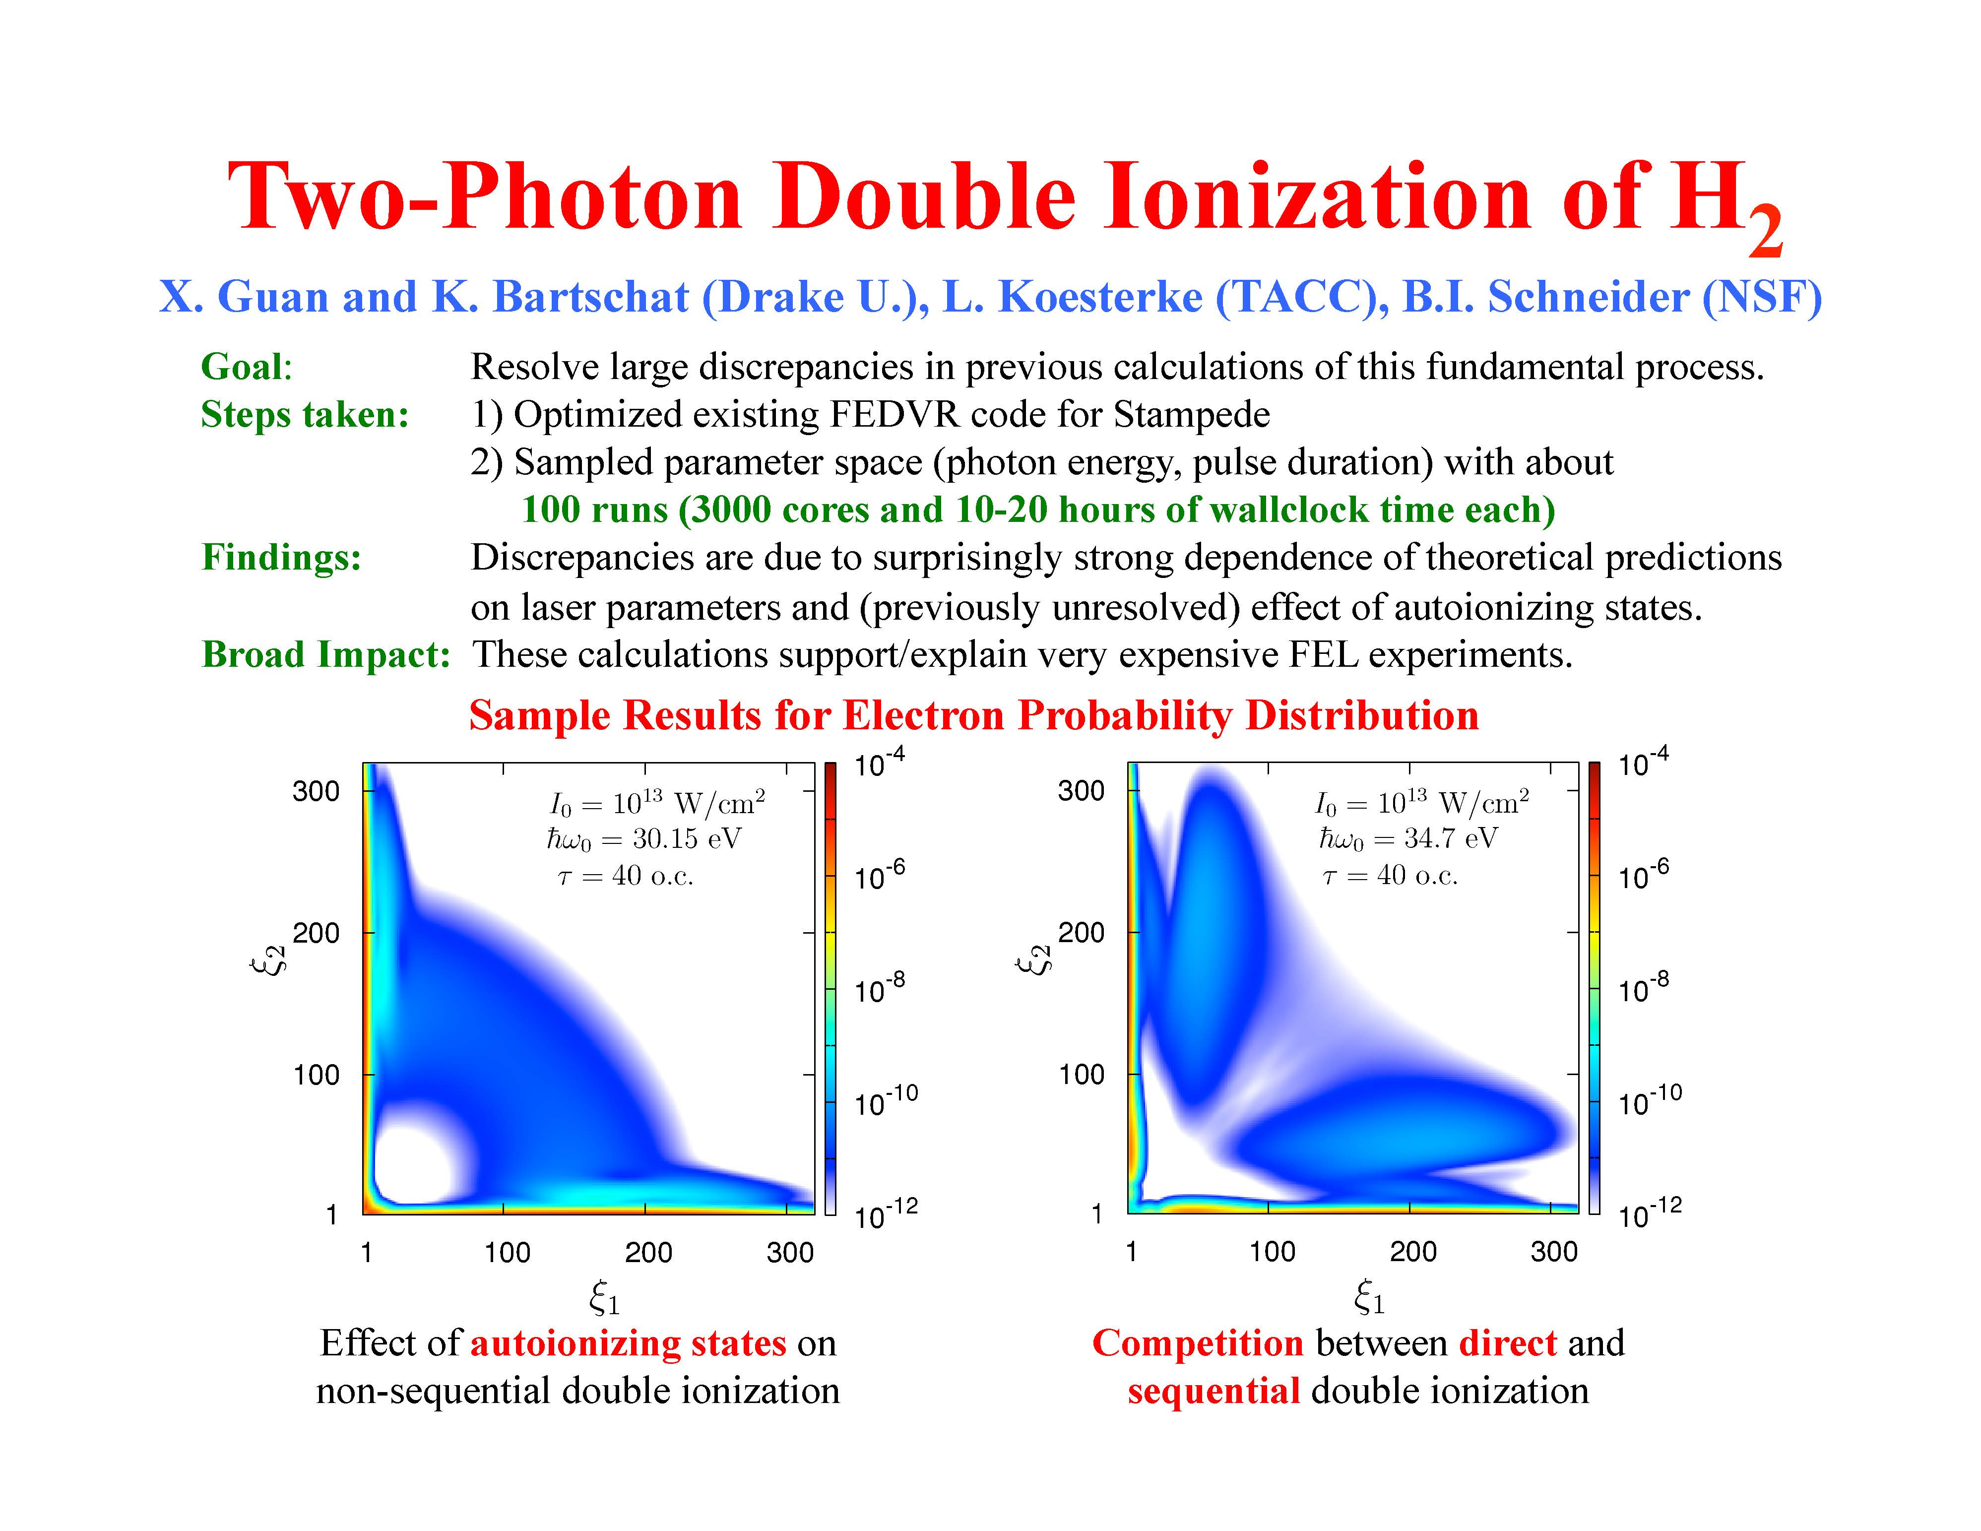
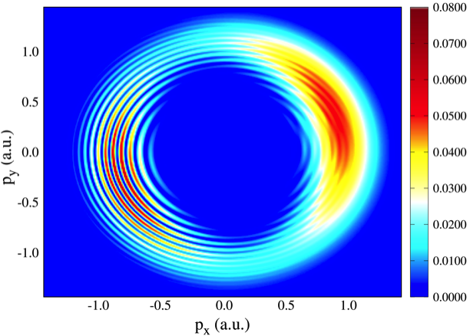
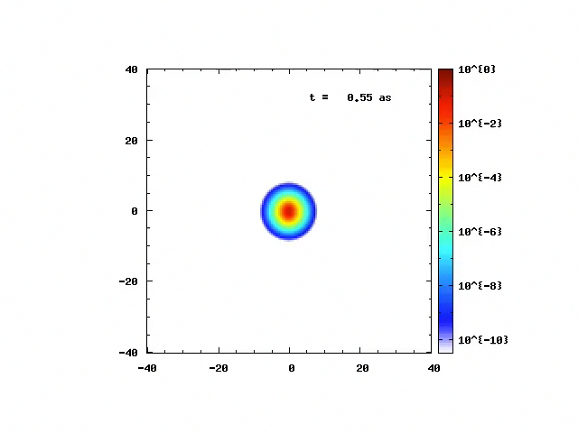
Ionization of Ar by electron Impact:Theory vs Experiment
Photoelectron Momentum Distribution for Ar
Ionization in Strong Electromagnetic Field
H⁺₂ Ionization in strong, ultrafast
electromagnetic field

Slide 2
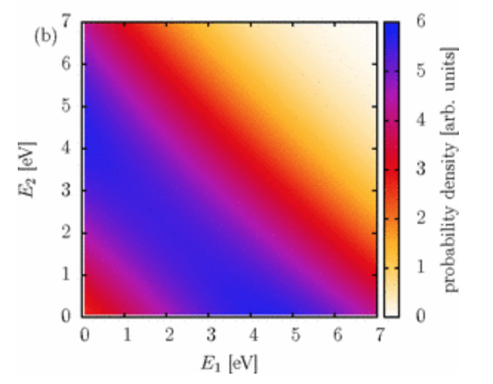
AMPGateway

